Slide 6
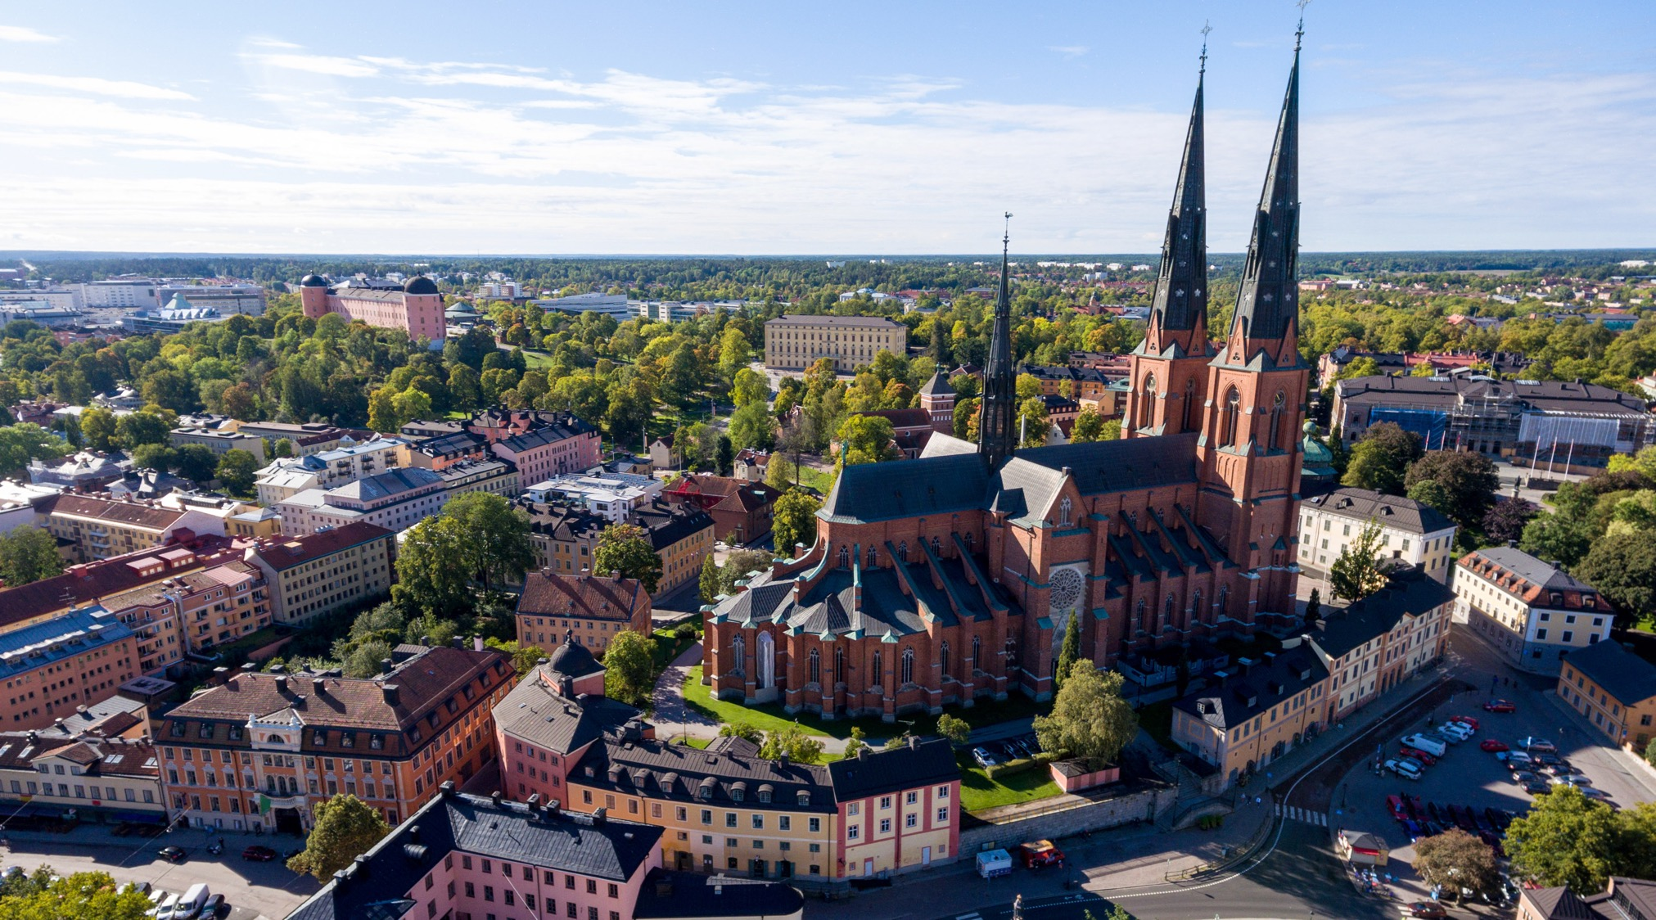

Slide 7
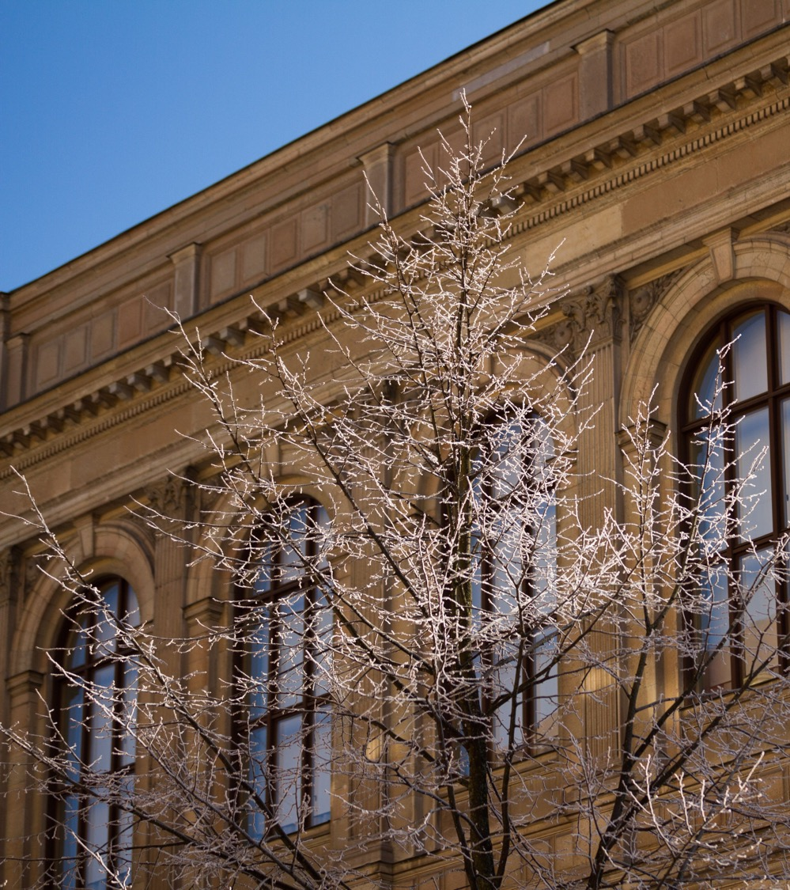
Welcome to Uppsala university
Always moving forward – since 1477
A meeting place for knowledge, culture and critical dialogue

Slide 8
Our mission
To gain and share knowledge for the benefit of humankind and for a better world

Slide 9
Our Goal: Research and Education of the Highest Quality and Relevance
The University proceeds from the insight that investing in education and research leads to a better future.
The University will put all its breadth and strength into supporting sustainable development and promoting openness and respect.
The University operates at the heart of the society to which it belongs. Collaboration and external engagement help us to make an impact and benefit society.
Uppsala University upholds the free pursuit of knowledge and stands up for academic integrity, diversity and quality.

Slide 10
Development Goals to Constantly Renew Education and Research
Expand education and strengthen the connection between education and research.
Develop research excellence.
Strengthen transdisciplinary and challenge-driven research.
Coordinate and concentrate the University’s resources.
Exploit the potential of Campus Gotland.
Develop collaboration as an integral part of education and research.

Slide 11
Strategic Priorities to Enhance Quality and Relevance
Quality assurance and enhancement
Internationalisation
Infrastructure
Talent attraction and career systems
Support and wider environment

Slide 12
In Brief
53,000 students and 7,600 employees
3 disciplinary domains – 9 faculties – 60 departments
Creative, interdisciplinary environments
400,000 square meters of facilities
SEK 8 billion turnover – 70% of it in research
Ranked among the world’s top universities

Slide 13
Ranking
Uppsala university among the best
All the universities in the world
There are more than 25,000 universities in the world. Uppsala universitet rankas bland de främsta.
ARWU (Shanghai Ranking)
THE (Times Higher Education)
QS Ranking
New ranking: QS World University Ranking: Sustainability. Measures universities’ efforts to move forward on sustainable development and has two components: environmental impact and social impact. Uppsala University 11th out of 700 universities worldwide. Best in the EU.

Slide 14
Education and Research in Three Disciplinary Domains
Humanities and
Social Sciences
6 faculties
Medicine och
Pharmacy
2 faculties
Science and
Technology
1 faculty

Slide 15
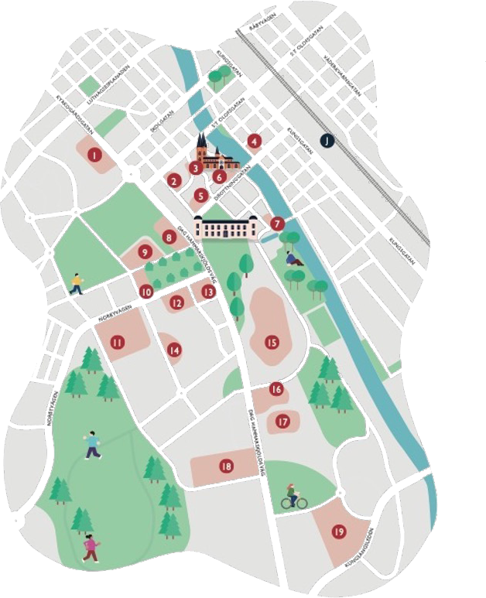
The Uppsala University Area
Ekonomikum
University Main Building
Gustavianum
Gamla torget Campus
Juridicum
Skytteanum
Munken Block
Uppsala University Library
English Park Campus
Botanical Garden
EBC – Evolutionary Biology Centre
Blåsenhus
Segerstedt Building
Geo Centre
Uppsala University Hospital
Rudbeck Laboratory
Uppsala Science Park
BMC – Uppsala Biomedical Centre
Ångström Laboratory

Slide 16
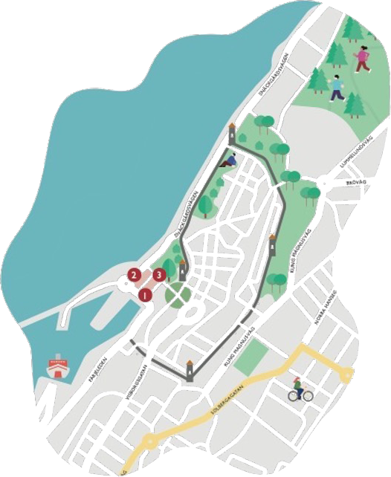
The Visby University Area
Campus Gotland
Science Park Gotland
Almedal Library

Slide 17
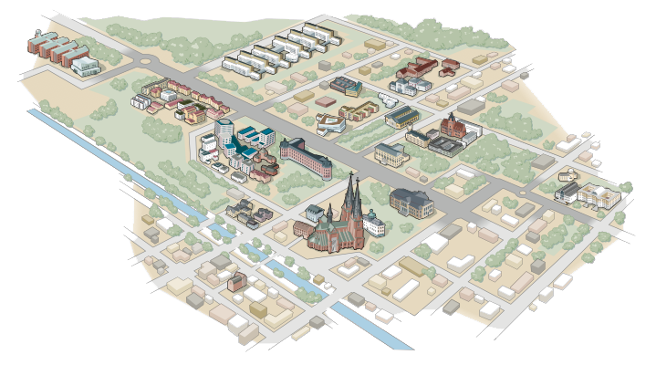
Uppsala

Slide 18
Campus Gotland

Slide 19
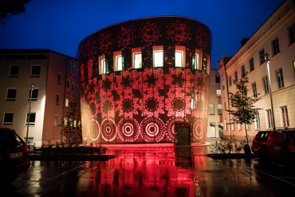
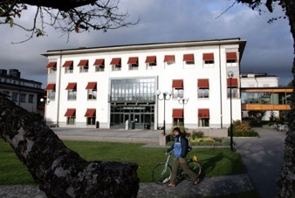
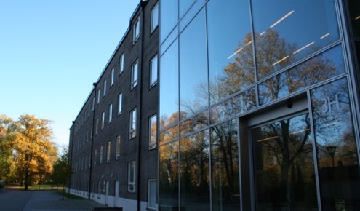
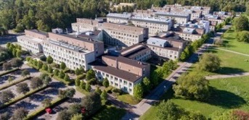
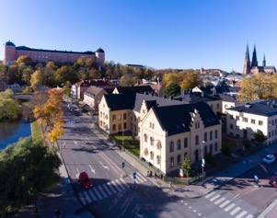
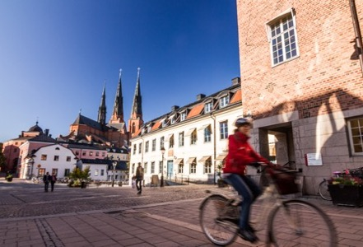
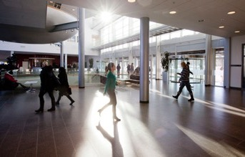
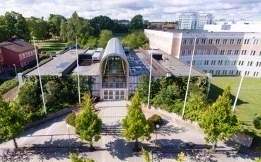
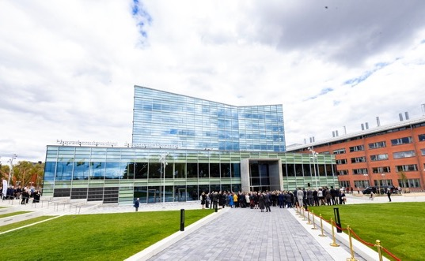

Slide 20
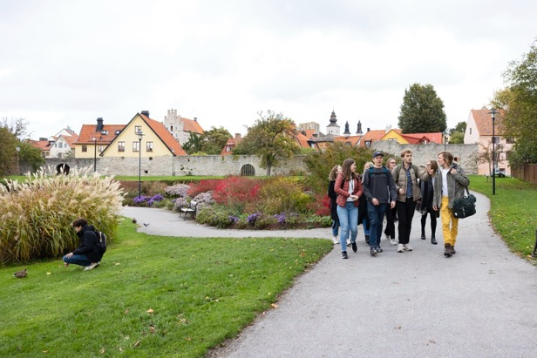
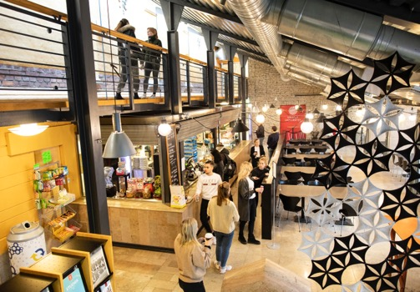
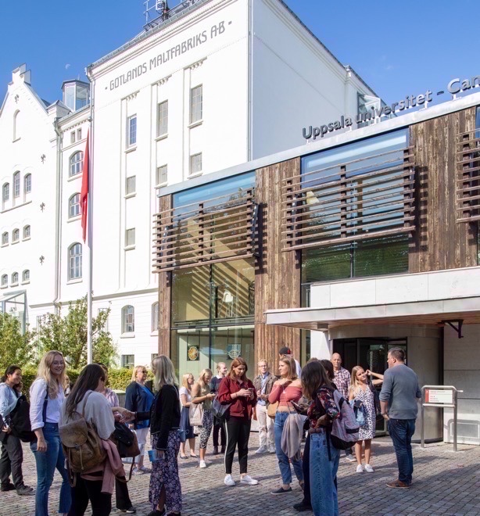

Slide 21
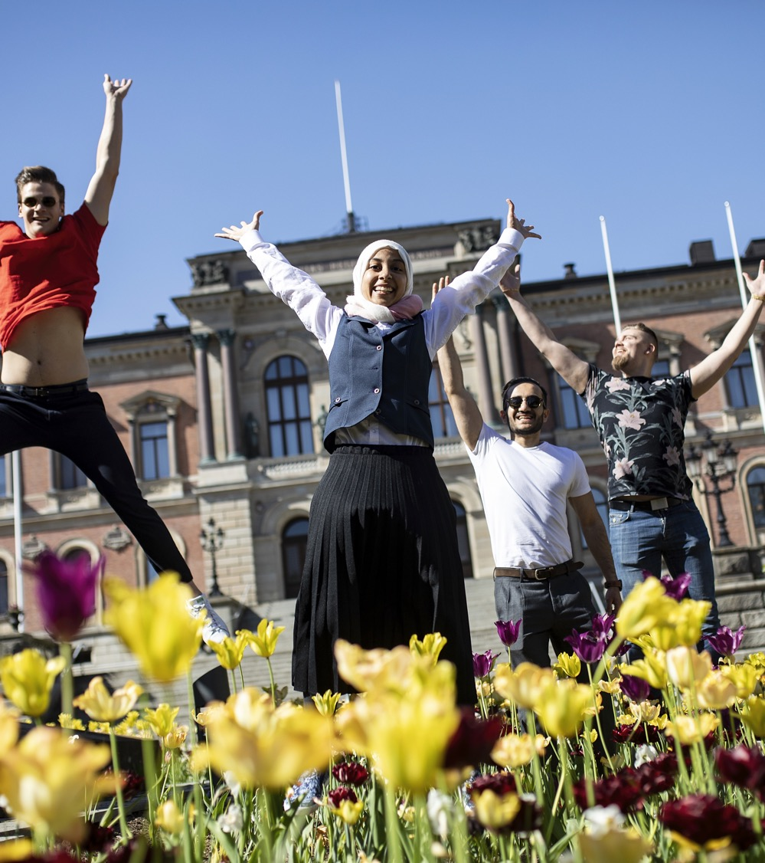
Education
Broad range of programmes
Research-based
Student life
Studentinflytande

Slide 22
Education in Numbers
53,000 students
80 Bachelor’s programmes
100 Master’s programmes
1,900 freestanding courses
Most popular programmes:law, medicine and psychology
6,400 degrees per year
80 international Master’s programmes and 7 international Bachelor’s programmes
680 freestanding courses in English
International student exchanges – 1,300 incoming students, 900 outgoing
1,700 fee-paying students

Slide 23
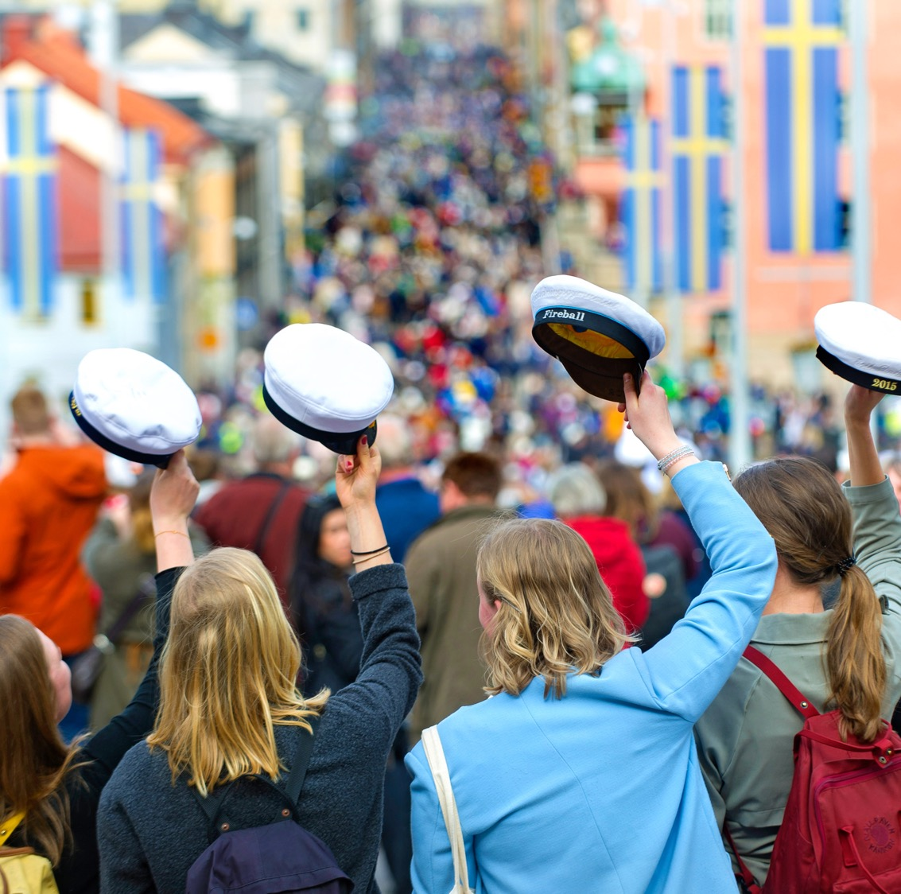
Student Life
13 Student Nations
6 Student’s Unions
Active Student Participation
Traditions

Slide 24
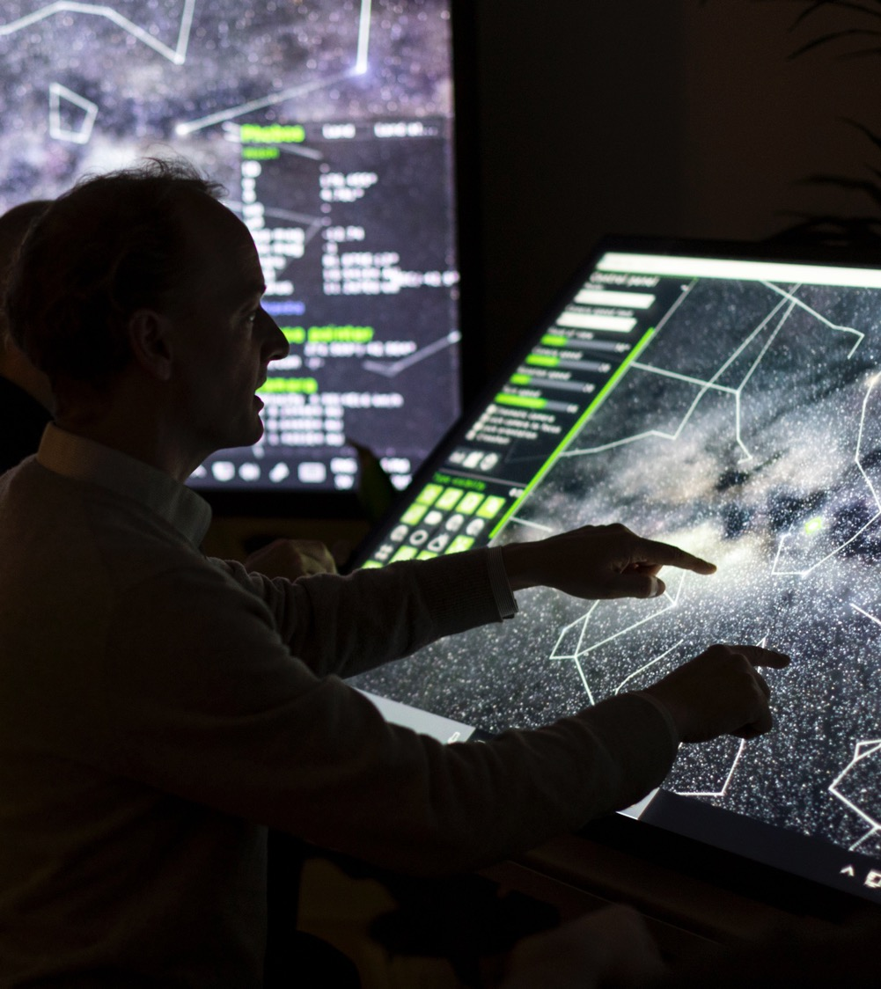
Research
Strong Individual Disciplines
Interdisciplinary
Internationalisation
Collaboration

Slide 25
We are Taking on the Research Challenges of the Future
Antibiotic Resistance
Artificial Intelligence
Biodiversity
Democracy
Digital Humanities
Energy
Public Health Diseases
Global Health
Climate Change
The Development of Life
Life Sciences
Drug Development
Medical Technology
Migration and Racism
Human Rights
New Materials
Mental Health
Social Sustainability

Slide 26
Research and Doctoral Programmes in Numbers
170 doctoral subject areas
2,500 doctoral students
350 doctoral degrees
5,000 peer-reviewed scholarly publications
Revenue for research and doctoral education: SEK 5,600 million (70% of total turnover)
50% of research funding from external sources

Slide 27
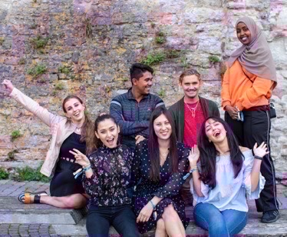
International Networks and Cooperation
Examples
The Guild
Coimbra
Southern African Nordic Centre (SANORD)
Matariki
Europauniversitetet Enlight
U4Society
The Baltic University Program
South Africa-Sweden University Forum (SASUF)
ACCESS
MIRAI 2.0
SIREUS
Uppsala University’s Alumni Network: 31,000 alumni in 150 countries

Slide 28
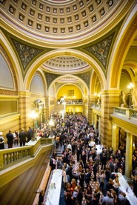
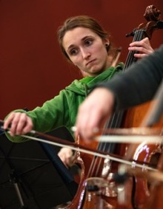
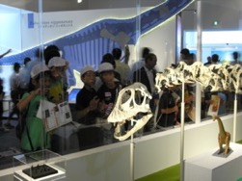
Living Cultural Heritage
Museums, art, historical cultural sites, academic traditions, music, gardens. Uppsala University has unique collections and rich cultural offerings.
Museums: Museum of Evolution, Gustavianum, Museum of Medical History, Uppsala University Library
Music: Royal Academic Orchestra, Uppsala University Jazz Orchestra, student nation choirs, student orchestras
Gardens: The Linnaeus Garden and the Botanical Garden are Sweden’s oldest botanical gardens. 9,000 species from all over the world are grown here.

Slide 30
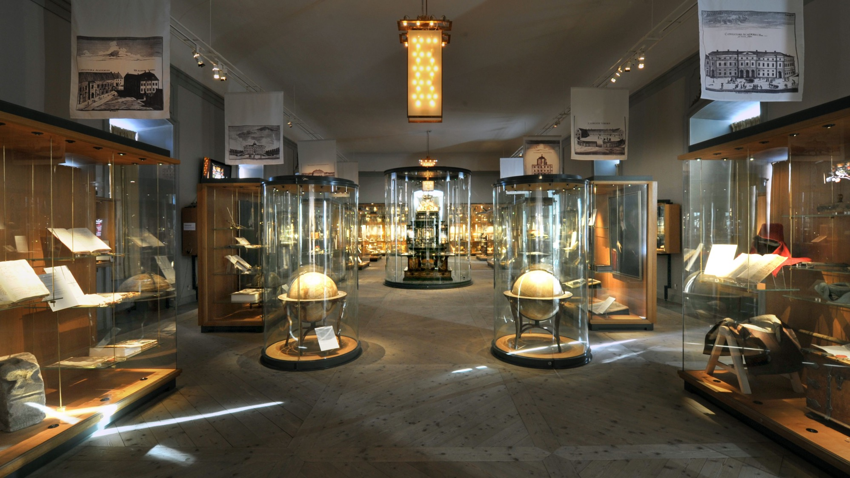

Slide 32
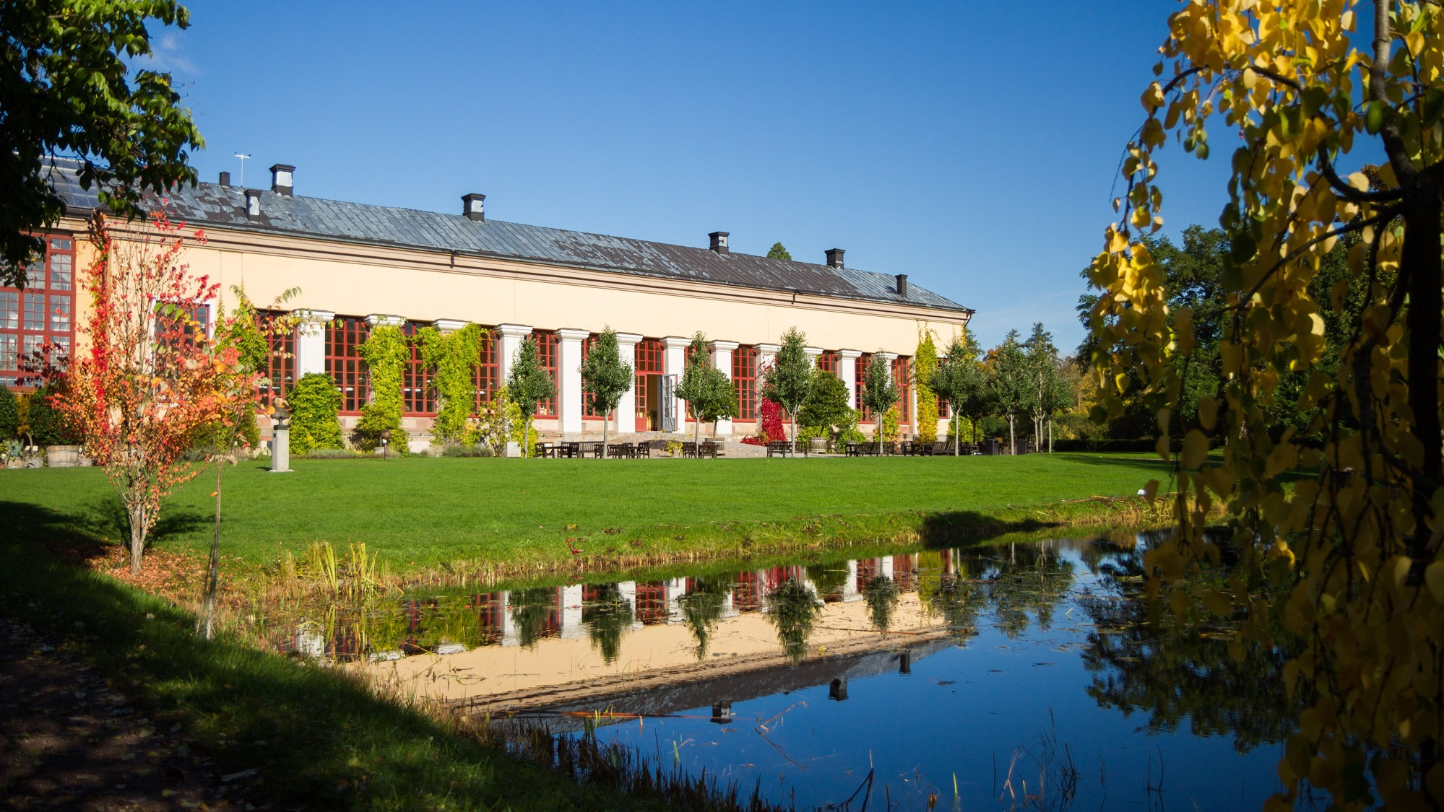

Slide 33
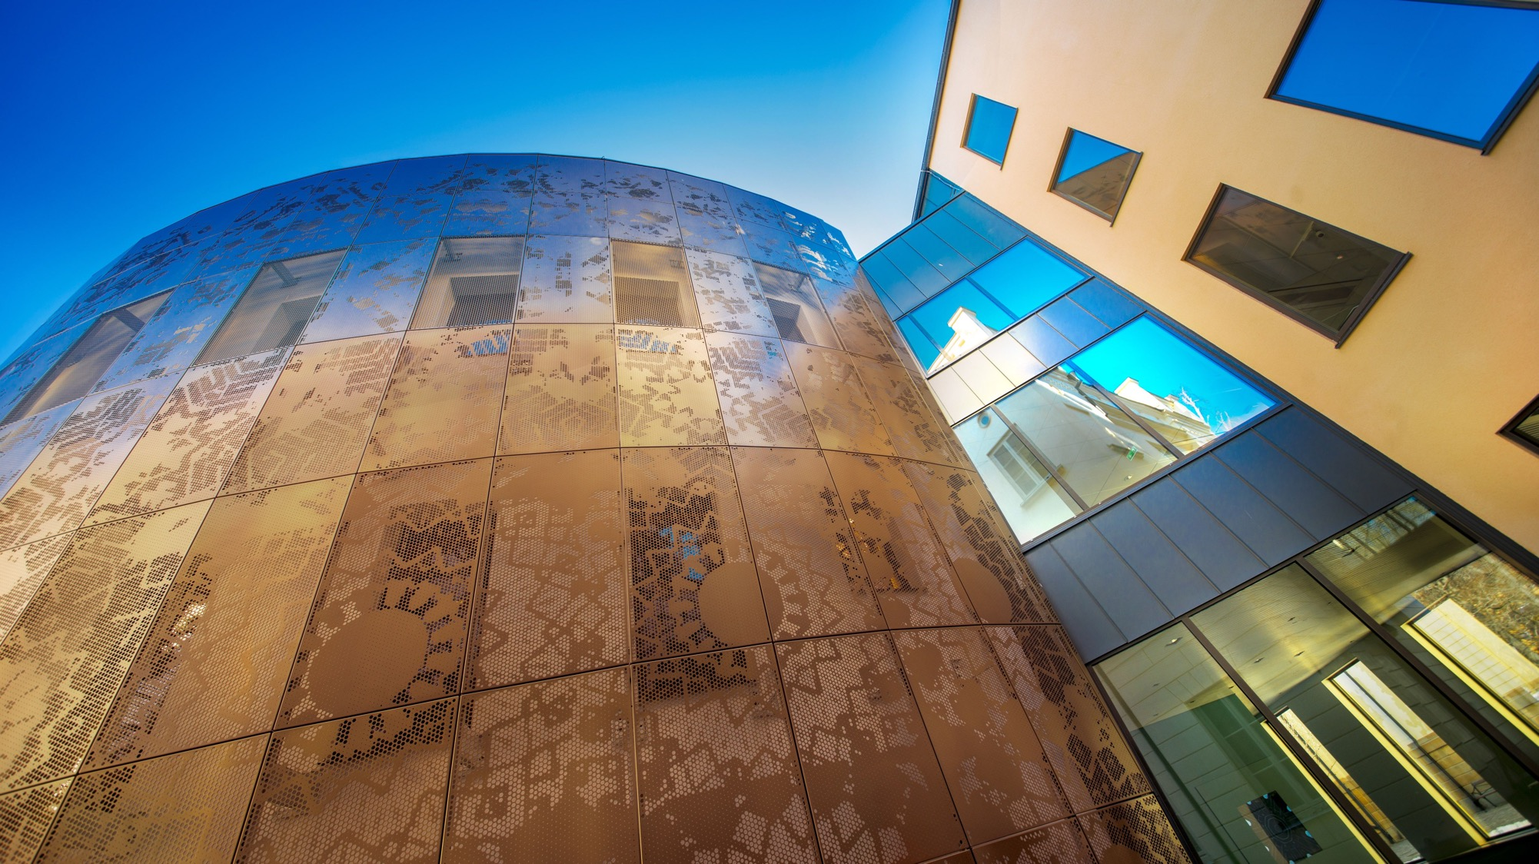

Slide 34
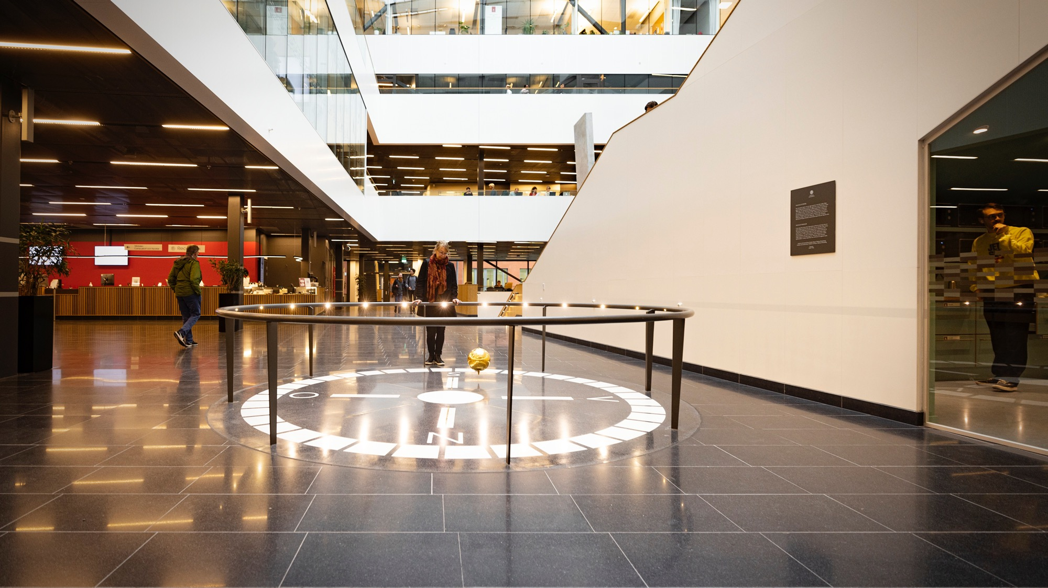

Slide 35
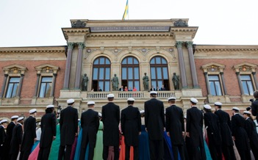
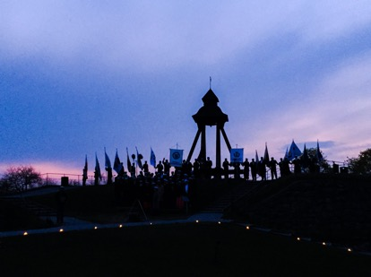
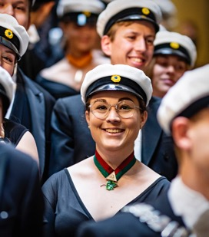
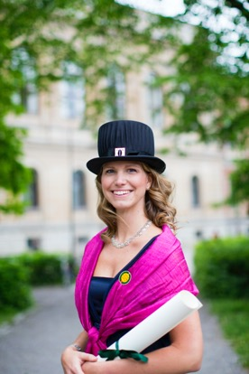
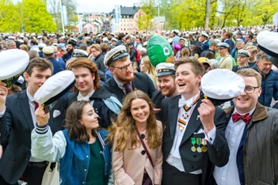
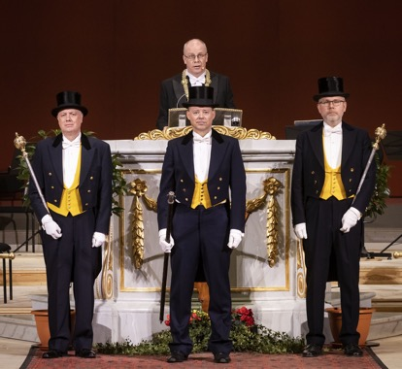
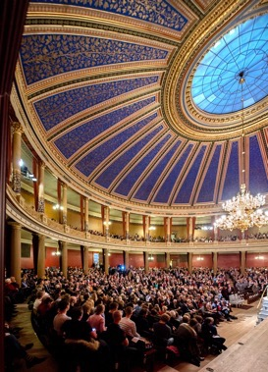
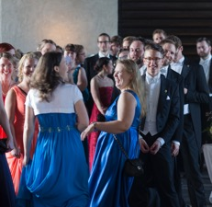
Living Traditions

Slide 36
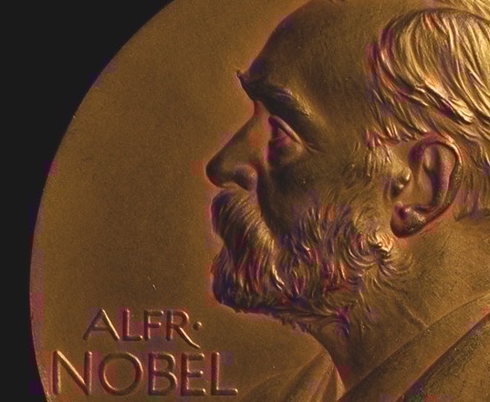
Nobel Laureates
Svante Pääbo – Physiology or Medicine 2022
Kai Siegbahn – Physics 1981
Dag Hammarskjöld – Peace 1961
Arne Tiselius – Chemistry 1948
Nathan Söderblom – Peace 1930
The Svedberg – Chemistry 1926
Manne Siegbahn – Physics 1924
Robert Bárány – Physiology or Medicine 1914
Allvar Gullstrand – Physiology or Medicine 1911

Slide 37
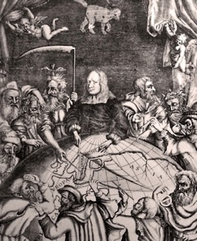
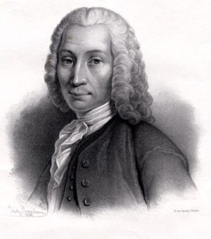
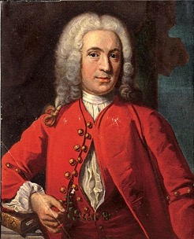
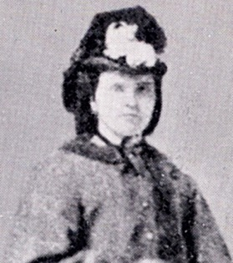
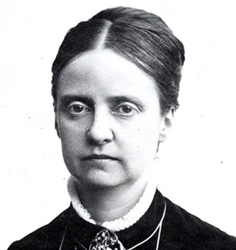
Some Famous Figures in Uppsala’s History
Olof Rudbeck
1630–1702
Anders Celsius
1701–1744
Carl von Linné
1707–1778
Betty Pettersson
1838–1885
Ellen Fries
1855–1900

Slide 38
Organisation
University Board
Electorial College
Internal Audit
Vice-Chancellor
University Administration
University Library
Disciplinary Domain
of Humanities
and Social Sciences
Disciplinary Domain
of Medicine
and Pharmacy
Disciplinary Domain
of Science
and Technology
Faculties
Theology
Law
Arts
Languages
Social Sciences
Educational Sciences
Faculties
Medicine
Pharmacy
Faculties
Science
And Technology
Departments
Departments
Departments

