Slide 1
Enabling human value through safe and reliable automation
Internship Opportunities at Sensmetry
Rūta Kaupinytė-Gotesman, HR Manager
Math Career Day 2023, UPSALA UNIVERSITET, 2023-04-25

Slide 2
HR Perspective
Growth
Identity
Positioning

Slide 3
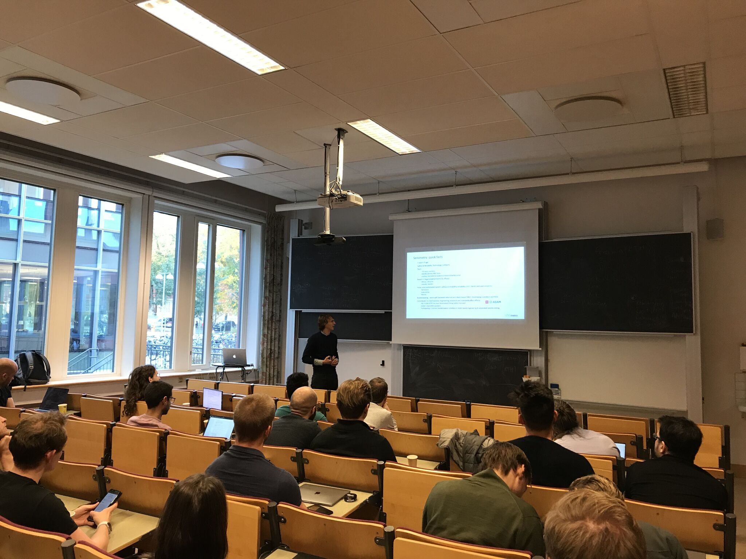
Math at Sensmetry
System Engineering and Controls
General Software Engineering
Embedded Software Engineering
Data Engineering Science
30
Team
2
Locations
International research team & top talent, 100% growth since 2021
Vilnius, Lithuania and Uppsala, Sweden.

Slide 4
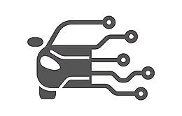
Our journey
2019-2020
2020-2023
2024+
AV Industry
Safety-Critical Systems
Space & Marine
Mission-Critical Systems
Digital Thread
Mission & Safety Critical Systems

Slide 5
Why intern at Sensmetry?
Meaningfulness
Growth
Complexity
Identity
Innovation
Positioning
Team

Slide 6
Connect with us
internships@sensmetry.com
www.sensmetry.com

